Slide 1
Wireframe for Community App

Slide 2
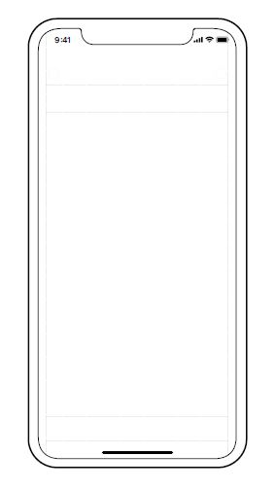
Login Screen
Seek Help Screen
Feedback Screen
REQUEST NAME
REQUEST NAME
USERNAME
Description
STATUS
Request Type (Remote/In person)
PASSWORD
Request Completed !!
Date and Duration
Time Period
FEEDBACK
LOGIN
Zip Code
SIGN UP
SUBMIT
SUBMIT
Provide Help
Seek Help
Provide Help
Seek Help

Slide 3
Active Requests Screen
Receiver Details Screen
Confirmation Screen
Feedback Screen
REQUEST NAME
Thank you for your help. Please contact help seeker on the contact number provided.
Notification is also sent to authority
for security purposes.
Help seeker has also received your contact details.
We appreciate that you are closing this request soon so you can get new requests.
REQUEST NAME
REQUEST 1
REQUEST 2
REQUEST 3
REQUEST 4
REQUEST 5
REQUEST 6
Description
VIEW
STATUS
VIEW
Request Type (Remote/In person)
VIEW
VIEW
Date and Duration
Request Completed !!
VIEW
VIEW
Time Period
Zip Code
FEEDBACK
Help Seeker Name
Help Seeker Name
Help Seeker Contact No.
Help Seeker Contact No.
SUBMIT
ACCEPT
DECLINE
Provide Help
Seek Help

Slide 4
Account Info Screen
Notifications Screen
Dashboard Screen
PROFILE
IMAGE
NOTIFICATIONS
DASHBOARD
HELPS PROVIDED
NAME
HELPS SOUGHT
CONTACT NO.
ZIP CODE
UPDATE

Slide 5
Help Screen
FAQs

Slide 6
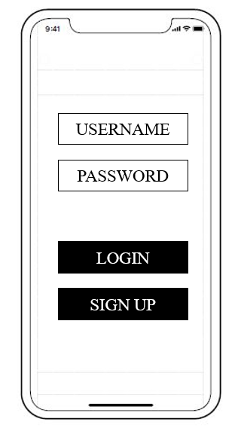
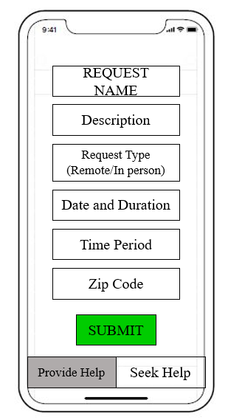
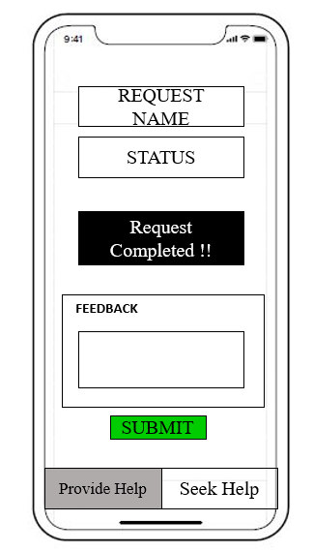
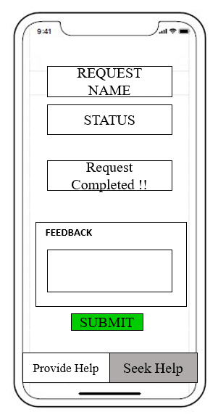
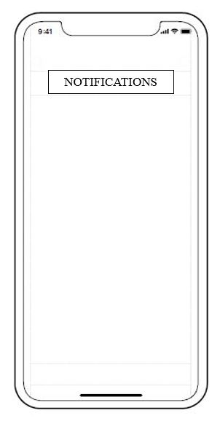
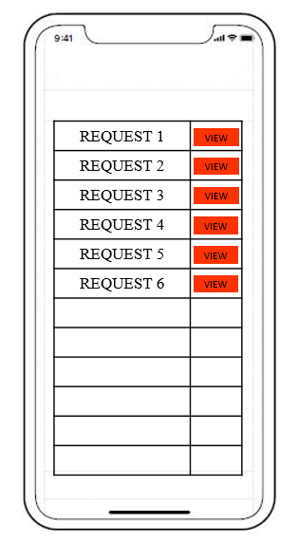
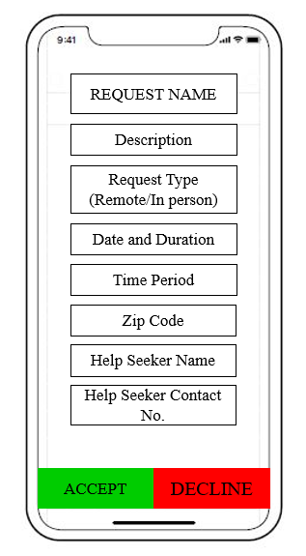
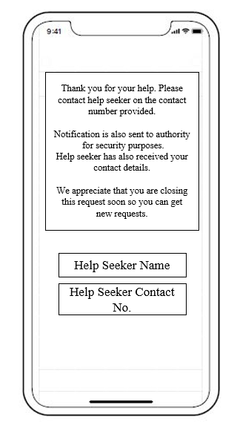
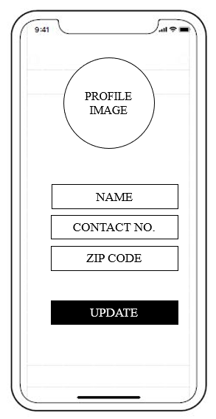
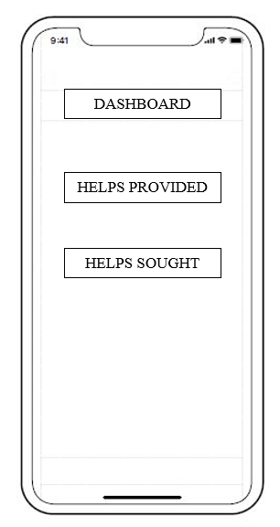

Slide 7
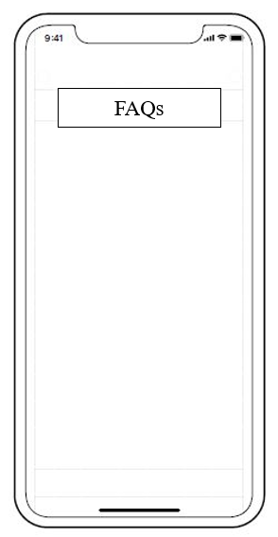
Login Screen
Seek Help Screen
Feedback Screen
Account Info Screen
Help Screen
Active Requests Screen
Receiver Details Screen
Confirmation Screen
Feedback Screen

